Slide 1

FINDING EMPLOYMENT AND EMPLOYEES
Presented by
Meghan Murray & Katrina Washington
Rick Scott Barbara Palmer
Governor Director

Slide 2
Mission Statement
The Agency supports persons with developmental disabilities in living, learning, and working in their communities.
Autism
Cerebral palsy
Spina bifida
Intellectual disabilities
Down syndrome
Prader-Willi syndrome
Phelan-McDermid syndrome (effective July 1, 2016)
Children ages 3-5 who are at a high risk of a developmental disability

Slide 3


Are You Ready to Challenge Yourself and
Demonstrate Your Abilities?
Employment
Diversity & Inclusion
Self-advocacy

Slide 4

Real Facts and Real Numbers about the Workforce
National Employment Rates for Persons with Disabilities and Without Disabilities
34.4% of individuals with a disability are working
75.4% of individuals without a disability are working
State of Florida Rates for Persons with Disabilities and Without Disabilities
39.1% of individuals with a disability are working
77.7% of individuals without a disability are working

Slide 5
Employment on a National Level
At the national level, there was a 41% employment difference between the two groups. At the State of Florida level, there was a 43.3% employment difference between the two groups.
Source: Compendium and the Annual American Community Survey (ACS), 2015.

Slide 6

Connecting Individuals with
Developmental Disabilities to APD
Connect individuals to APD as soon as possible
Apply for services by submitting an online application to the local APD office in your area
Applications can be found at www.apdcares.org/customers/applications/
Contact your local APD office for questions and the application process
Documentation of a developmental disability may include, but is not limited to school records, testing, or medical records

Slide 7

The Competitive Edge in the 21st Century Workforce
Employers view soft skills as even more important to work readiness for the 21st century:
Networking – Being able to reach out to people beyond the ones you know; engaging new employers
Enthusiasm – Being excited about the job and being able to express why you would be a good employee
Professionalism – Make sure your resume is dressed to impress and tailored for the job; dress appropriately for work
Communications Skills – Learn how and when to share your concerns in the workplace; self-advocacy is the key
Teamwork – Successful businesses rely on team players and those who are able to work independently

Slide 8
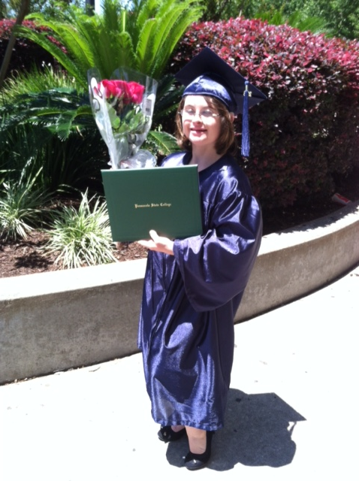
Employment in the 21st Century
This Could Be You
Phillip Cheeseborough
AMC Theatres
Cameron Northrup
Licensed Esthetician
Graham Glover
Publix

Slide 9

21st Century Employers Are Hiring
Are You Ready to Work?
Employers Are Hiring
Are You Ready to Work?
Do you have a resume and a cover letter?
Have you applied for jobs?
Have you practiced interviewing techniques?
Is there a special interviewing outfit? Always dress for success.
Are you networking in your community?
Identify companies that are hiring by attending local job fairs.
They are desperately in need of hard workers
There is a shortage of qualified workers
It’s time to visit diverse industries that we’ve never approached in the workforce, i.e., air conditioning, construction, and related trades

Slide 10
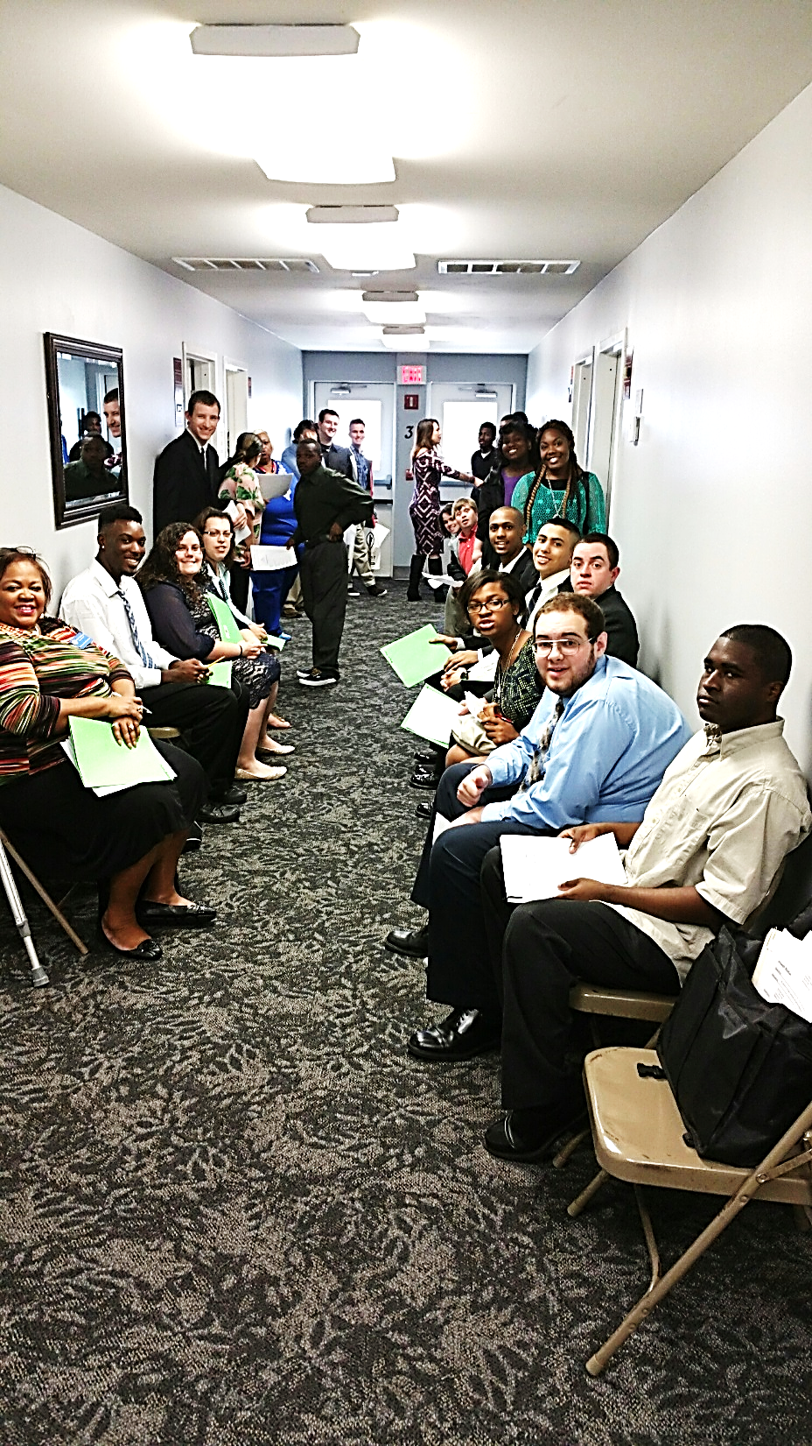
Building Successful Partnerships
Implement student mock interview workshops
Help students obtain competitive employment with an income of minimum wage or higher while attending school
Ensure students on the APD Waiting List are connected with a job coach prior to transitioning from high school
Connect schools with employers

Slide 11
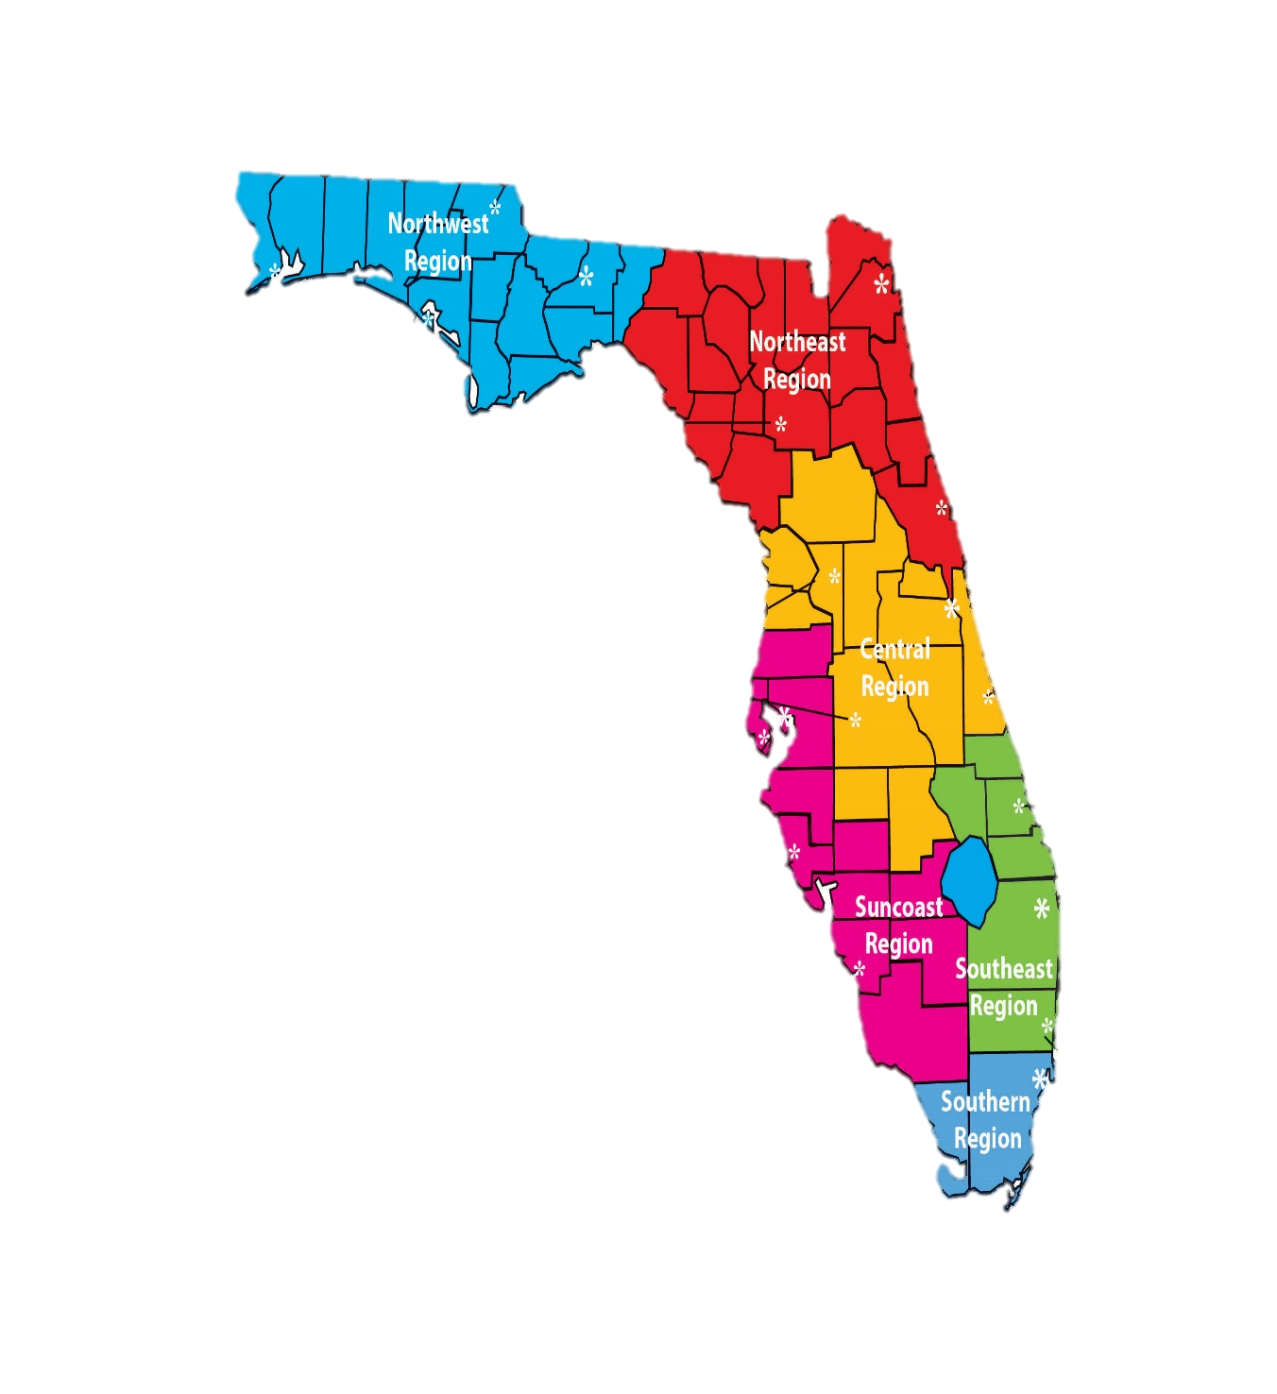


Statewide School Partnerships
APD is working with schools statewide to identify ESE students that are on the APD Waiting List between the ages of 18 to 22
Schools will need to have parents complete a consent to release form prior to releasing information to APD
Students 18 and older will be able to receive supported employment services while attending school
APD isn’t able to successfully serve students without your assistance

Slide 12

Employment Enhancement Plan
(EEP)
Florida Governor Rick Scott and Florida Legislators have appropriated $500,000 to APD for the Fiscal Year (FY) 2016/17 to help APD clients on the Waiting List to find and maintain employment and/or internships. APD was appropriated $750,000 for fiscal year 2017/2018.
Success Rate: We have 434 positive employment and internship outcomes
Job Seekers must be:
At least 18 years old
On the APD Waiting List
Interested in having a job

Slide 13
Employment Enhancement Project
Highest priority will be for students transitioning from high school to begin working in competitive employment
Employment Enhancement Project (EEP) funds are non-recurring, with optimistic projections for additional funds for future fiscal years
Services will be provided by APD Supported Employment Providers
Services to be funded include:
  Supported employment coaching
  Follow-along services
  Paid internships
  Transportation
Participation in EEP does not affect an individual’s Waiting List status. This project is specific to employment.

Slide 14
Maintain Social Security Benefits
Helpful tips for individuals and families with disabilities
Stress the importance of individuals 18 years and older having a shelter obligation
Individuals will receive the maximum Supplemental Security Income (SSI) benefit amount of $735.00
If students are under the age of 18 and they are not eligible for SSI benefits due to their parents’ income, encourage the student to apply for benefits at the age of 18 because the parents’ income is excluded from a child's SSI benefits at the age of 18

Slide 15

Students Earned Income Exclusion
SSI ONLY SOCIAL SECURITY WORK INCENTIVE FOR STUDENTS
This provision allows a person who is under age 22 and regularly attending school to exclude earnings from income.
Amount earned that can be excluded is adjusted annually based on increases in the cost-of-living index
This exclusion applies before any other exclusion
Can carry the balance over to the next month
In January 2017 - $1,790 monthly and up to a yearly maximum of $7,200

Slide 16

Impairment Related Work Expense (IRWE)
SSI and SSDI Work Incentive
Out-of-pocket expenses that support a disability to allow a person to earn income, even if those items or services are also needed for non-work activities can be deducted from the amount of earnings.
Ex: Transportation, medication, medical devices, and personal care assistance
This means SSI benefits are not reduced as much

Slide 17
The Able Act
Effective July 1, 2016
Save for the future without losing Supplemental Security Income
Generally, funds in (or withdrawn from) an ABLE account are disregarded when determining SSI eligibility.
Exceptions:
ABLE funds over $100,000
Housing and non-qualified disability expenses withdrawn but not spent that month
Able Accounts
Save like never before
A tax-free savings and investment account established to support disability expenses while maintaining government benefits
A $2,000 asset limit is no longer a barrier
Increase savings through tax-free growth
Receive contributions from family and friends

Slide 18
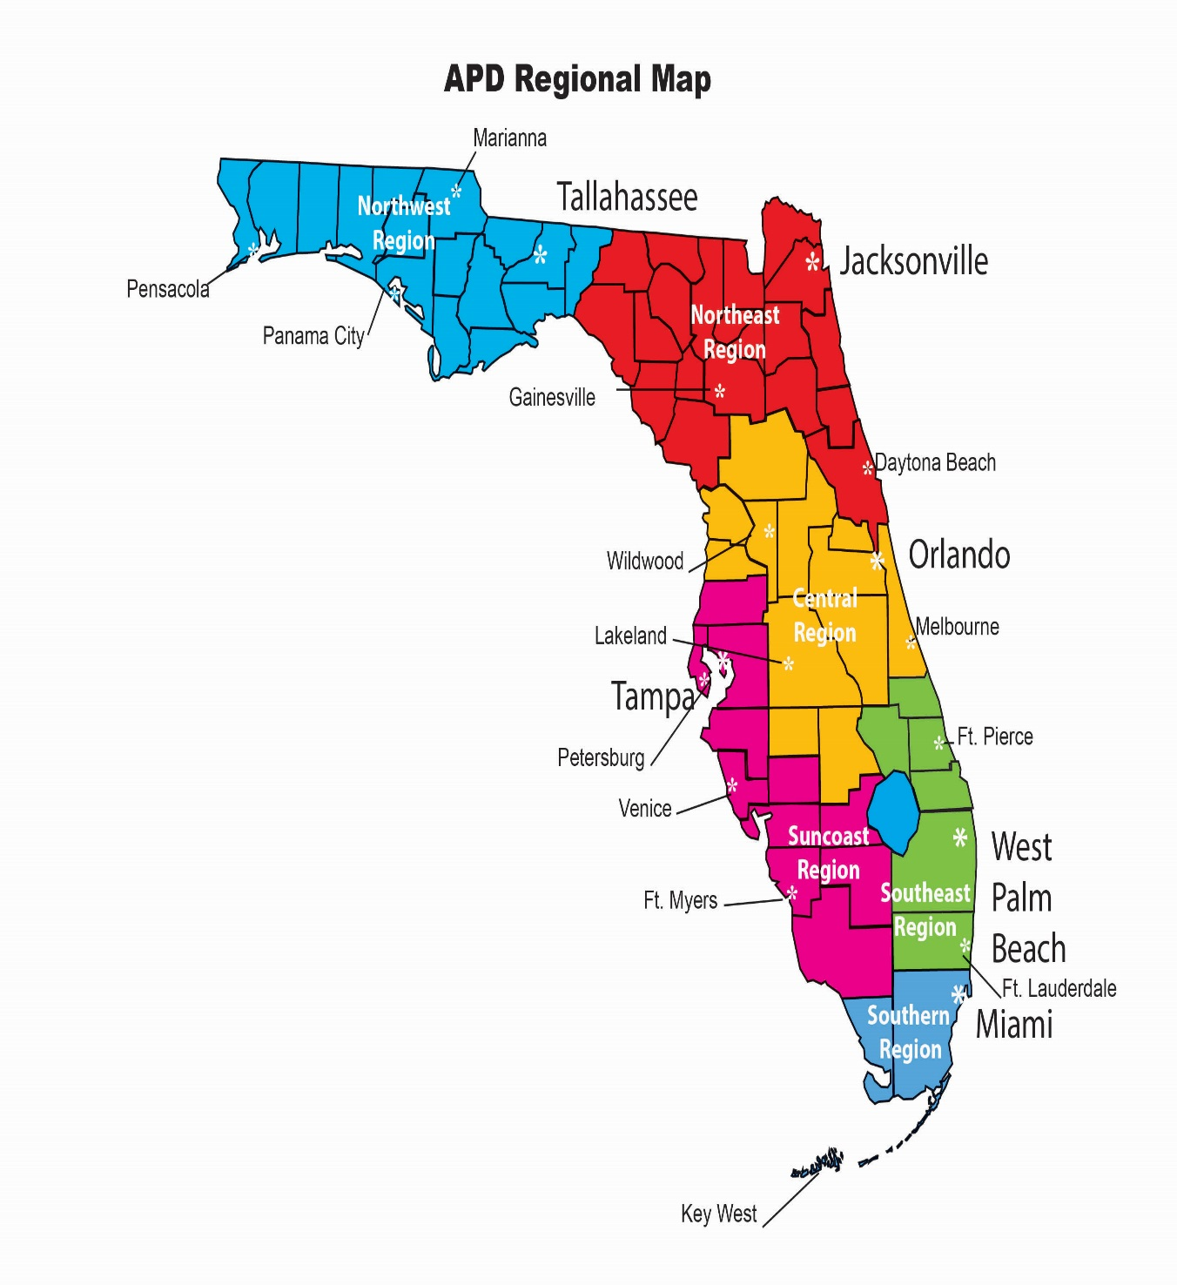
Northwest Region (850) 595-8351
Interim Supported Employment Liaison: Annette Zeeb
Phone: 850-595-8307 Email: Annette.Zeeb@apdcares.org
Counties served: Bay, Calhoun, Escambia, Franklin, Gadsden, Gulf, Holmes,
Jackson, Jefferson, Leon, Liberty, Okaloosa, Santa Rosa, Wakulla, Walton, and Washington counties
Northeast Region (904) 992-2440
Supported Employment Liaison: Helen Cooke
Phone: 352-955-6424 Email: Helen.Cooke@apdcares.org
Counties served: Alachua, Baker, Clay, Columbia, Dixie, Duval, Flagler, Gilchrist,
Hamilton, Lafayette, Levy, Madison, Nassau, Putnam, St. Johns, Suwannee, Taylor, Union, and Volusia counties
Central Region (407) 245-0440
Supported Employment Liaison: Mollie Brown-Ferrier
Phone: 863-413-3377 Email: Mollie.Brown-Ferrier@apdcares.org
Supported Employment Liaison: Earl Solano
Phone: 407-245-0440 Email: Earl.Solano@apdcares.org
Supported Employment Liaison: Elizabeth Watson
Phone: 352-330-2739 Email: Elizabeth.Watson@apdcares.org
Counties served: Brevard, Citrus, Hardee, Hernando, Highlands, Lake, Marion, Orange, Osceola, Polk, Seminole, and Sumter counties
Suncoast Region (812) 233-4300
Supported Employment Liaison: Debra Noel
Phone: 813-233-4449 Email: Debra.Noel@apdcares.org
Supported Employment Liaison: Jim Vidrine
Phone: 239-338-1378 Email: James.Vidrine@apdcares.org
Counties served: Charlotte, Collier, DeSoto, Glades, Hendry, Hillsborough, Lee, Manatee, Pasco, Pinellas, and Sarasota counties
Southeast Region (561) 837-5564
Supported Employment Liaison: Milory Senat
Phone: 561-398-2240 Email: Milory.Senat@apdcares.org
Counties served: Broward, Indian River, Martin, Okeechobee, Palm Beach and St. Lucie counties
Southern Region (305) 349-1478
Supported Employment Liaison: Michelle Alamo
Phone: 305-349--1299 Email: Michelle.Alamo@apdcares.org
Supported Employment Specialist: Michael Cardello
Phone: 305-808-6236 Email: Michael.Cardellow@apdcares.org
Counties served: Dade and Monroe counties

Slide 19
Resources
The Able Trust – www.abletrust.org
Agency for Persons with Disabilities - www.apdcares.org
CareerSource Florida - www.careersourceflorida.com
Disability Resources – www.disability.gov
Disability Scoop - www.disabilityscoop.org
Employment Websites - www.indeed.com and www.employflorida.com
Florida Commission for Transportation Disadvantaged - www.dot.state.fl.us/CTD
Florida Developmental Disabilities Council - www.fddc.org
Jobs Accommodation Network – www.askjan.org
National Disability Institute (NDI) - www.realeconomicimpact.org
Social Security Administration - www.ssa.gov
Vocational Rehabilitation - www.rehabworks.org

Slide 20
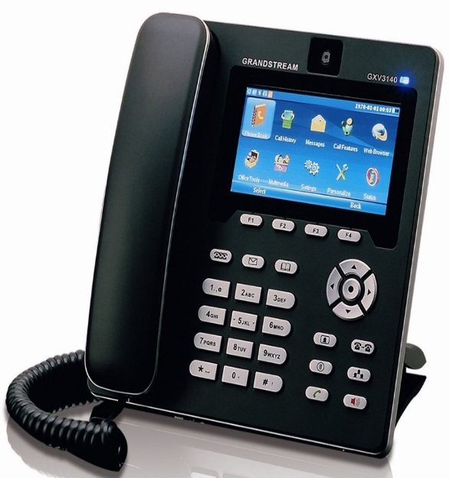
Contact Information
Meghan Murray
Agency for Persons with Disabilities
State Office Community Supports
4030 Esplanade Way, Suite 380 Q, Tallahassee, FL 32399
Office: 850-410-2876/Cell: 850-694-2325
Email: Meghan.Murray@apdcares.org
Katrina Washington
Agency for Persons with Disabilities
State Office Community Supports & Supported Employment
160 Government Street, Suite 412, Pensacola, FL 32502
Office: 850-595-8329/Cell: 850-556-5859
Email: Katrina.Washington@apdcares.org

Slide 21

Thank You!

